Slide 1
Creating a Comprehensive Web Application Fuzzer
CSE7310 University Project
Review-4
Batch Number: CSE-G93
Roll No | Student Name
20211CSE0591 | Mohan R Shetty
20211CSE0599 | Suchithra K
20211CSE0607 | Sumanth R
20211CSE0584 | Amulya S Sathish
Under the Supervision of,
Ms. Vineetha B
Assistant Professor
School of Computer Science and Engineering
Presidency University
Name of the Program: CSE
Name of the HoD: Dr. Asif Mohammed H.B
Name of the Program Project Coordinator: Mr. Jerrin Joe Francis
Name of the School Project Coordinators: Dr. Sampath A K

Slide 2
Content
Problem Statement
Analysis of Problem Statement
Literature Survey
Objectives
References

Slide 3
Problem Statement Number: PSCS451
Organization: National Critical Information Infrastructure Protection Center (NCIIPC)
Category (Hardware / Software / Both) : Software
Problem Description: This model outlines the development of a comprehensive web application fuzzer to identify and mitigate vulnerabilities in web components such as directories, virtual hosts, API endpoints, URL parameters, custom test cases, and subdomains. It emphasizes systematic enumeration, testing for common vulnerabilities, and incorporating user-defined scenarios for targeted analysis. The framework includes detailed reporting, prioritization of issues, and actionable remediation strategies. Key benefits include early detection of security issues, improved code quality, enhanced developer awareness, and strengthened application security before deployment.

Slide 4
Analysis of Problem Statement
Technology Stack Components:
Frontend: HTML, CSS, JavaScript
Backend: Flask, SQLite
Programming Language: Python

Slide 5
Analysis of Problem Statement (contd...)
Software and Hardware Requirements:
Operating System : Windows/ mac
Python
SQLite
IDE : VSCode

Slide 6
Analysis of Problem Statement (contd...)
Web applications are fundamental to online services but are highly susceptible to cyber-attacks due to their complexity and widespread usage. Hidden components like directories, virtual hosts, API endpoints, URL parameters, and subdomains are common targets for attackers. Identifying vulnerabilities in these areas through comprehensive fuzzing enhances web application security.
A Web Application Fuzzer is a tool used to test web applications by sending unexpected, random, or malicious inputs to identify vulnerabilities, errors, and security weaknesses.
The core idea of this model is to detect the vulnerabilities or other errors that is related to security and to analyse them. This project aims to develop an automated fuzzer to identify and test these components for security flaws. The fuzzer will systematically enumerate and test hidden directories, API endpoints, and subdomains while fuzzing URL parameters for injection attacks. It will also allow custom test cases to address specific vulnerabilities. By automating the detection of vulnerabilities early in development, this approach improves code quality, raises security awareness, and reduces the risk of exploitation, ultimately enhancing the web application’s security before deployment.

Slide 7

Analysis of Problem Statement (contd...)
What is Fuzzing?
Fuzzing is an automated testing technique used to identify vulnerabilities in software by inputting random, malformed, or unexpected data (payloads) into the application. The goal is to uncover security flaws, such as buffer overflows, SQL injection, and cross-site scripting (XSS), by exposing the software to various inputs it might not encounter in normal use. Fuzzing helps detect vulnerabilities early in the development process, allowing developers to fix issues before the application is deployed to production. It is an essential tool in proactive security measures, enhancing the overall robustness and resilience of web applications.

Slide 8
Literature Survey:
In [1] this model, the results show that the improved algorithm can generate better test cases than the standard genetic algorithm (SGA) and the adaptive genetic algorithm (AGA) and also detect more web vulnerabilities. It shows provides a good and accurate security vulnerabilities.
In paper [2], the author has discussed the applications of fuzzing technique in both web and other areas. We also present a case study by implementing a fuzzer in this study. This paper also gives an idea for invention of new techniques for identifying threats and vulnerabilities.
In paper[3],the author investigates the latest research results in fuzzing and provides a systematic review of machine learning-based fuzzing techniques. Firstly, by outlining the workflow of fuzzing, it summarizes the optimization of different stages of fuzzing using machine learning. Specifically, it focuses on the application of machine learning in the preprocessing phase, test case generation phase, input selection phase and result analysis phase. Secondly, it mentally focuses on the optimization methods of machine learning in the process of mutation, generation and filtering of test cases.
In paper [4], they have developed a platform and tools for web application fuzz testing automation that can be integrated to Jenkins. The tool has been tested on web applications with known vulnerabilities. In 13 of the 15 test cases, the tool can successfully found the presence of vulnerabilities. Based on the results, most vulnerabilities can be detected based on HTTP response content.

Slide 9
Objectives:
Automate Security Testing to Detect Vulnerabilities Efficiently
One-Time Login Credential for All Sessions
Interactive Dashboard
Reduce False Positives by Implementing Intelligent Result Validation
Reusable Accounts

Slide 10
Existing method Drawback
Limited Payload Variety: The fuzzer in this model uses a fixed set of test cases.
No Support for Authentication-Based Testing: The model does not handle authentication tokens, sessions, or OAuth-protected APIs effectively.
No Automated Reporting and Visualization: The fuzzer only displays raw test results on the dashboard.
No API-Specific Testing
Limited Protocol Support

Slide 11
Proposed Method
Tools like Burp Suite, AFL (American Fuzzy Lop) use mutational fuzzing to create new test cases dynamically based on responses.
Modern fuzzers support authenticated fuzzing, where they log in, maintain session tokens, and test protected endpoints.
Proposed method provide detailed vulnerability reports.
Implementing tools that that detects Broken authentication, Misconfigured CORS settings, Unintended data exposure.
Advanced fuzzers support by websockets and other tool.
Provides detailed explanation with visualization through charts.

Slide 12
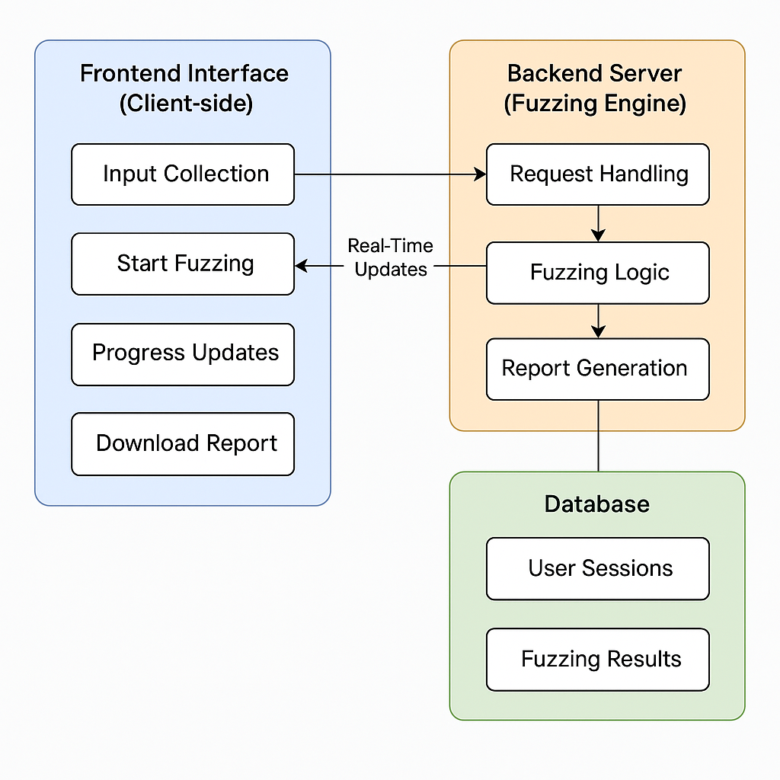
Architecture Diagram

Slide 13
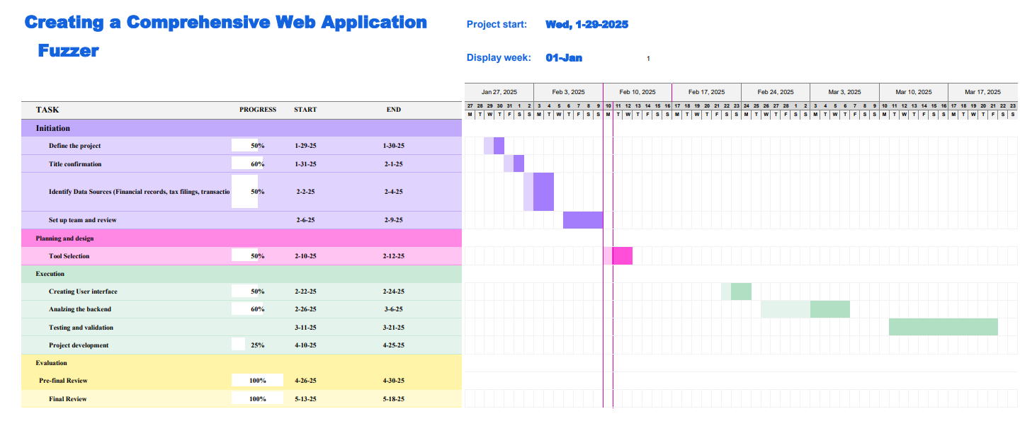
Timeline of project

Slide 14
References (IEEE Paper format)
[1] Web Application Vulnerability Fuzzing Based On Improved Genetic Algorithm
X. Zhou and B. Wu, "Web Application Vulnerability Fuzzing Based On Improved Genetic Algorithm," 2020 IEEE 4th Information Technology, Networking, Electronic and Automation Control Conference (ITNEC), Chongqing, China, 2020, pp. 977-981, doi: 10.1109/ITNEC48623.2020.9084765.
[2] Fuzzing Technique in Web Applications and Beyond
Zhao, Danyang. (2020). Fuzzing Technique in Web Applications and Beyond. Journal of Physics: Conference Series. 1678. 012109. 10.1088/1742-6596/1678/1/012109.
[3] Machine Learning-Based Fuzz Testing Techniques: A Survey
[4]Web Application Fuzz Testing
Andrianto, Ivan & Liem, M. & Asnar, Yudistira. (2017). Web application fuzz testing. 1-6. 10.1109/ICODSE.2017.8285893.

Slide 15
References
[5] Fuzzing Frameworks for Server-side Web Applications: A Survey
[6] Whole-Function Fuzzing for Applications and Libraries
Y. Liu, Y. Wang, X. Jia, Z. Zhang and P. Su, "AFGen: Whole-Function Fuzzing for Applications and Libraries," 2024 IEEE Symposium on Security and Privacy (SP), San Francisco, CA, USA, 2024, pp. 1901-1919, doi: 10.1109/SP54263.2024.00011.
[7] Design and Implement Binary Fuzzing Based on Libfuzzer
W. -C. Chao, S. -C. Lin, Y. -H. Chen, C. -W. Tien and C. -Y. Huang, "Design and Implement Binary Fuzzing Based on Libfuzzer," 2018 IEEE Conference on Dependable and Secure Computing (DSC), Kaohsiung, Taiwan, 2018, pp. 1-2, doi: 10.1109/DESEC.2018.8625172.

Slide 16
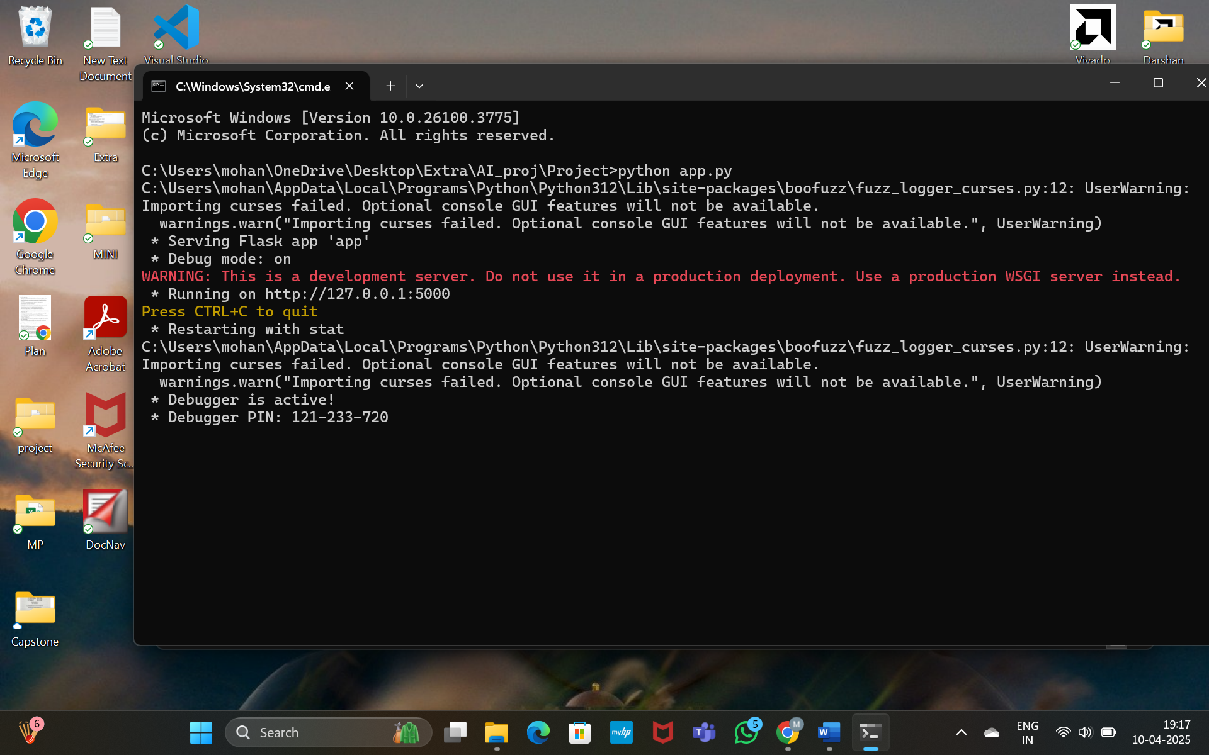
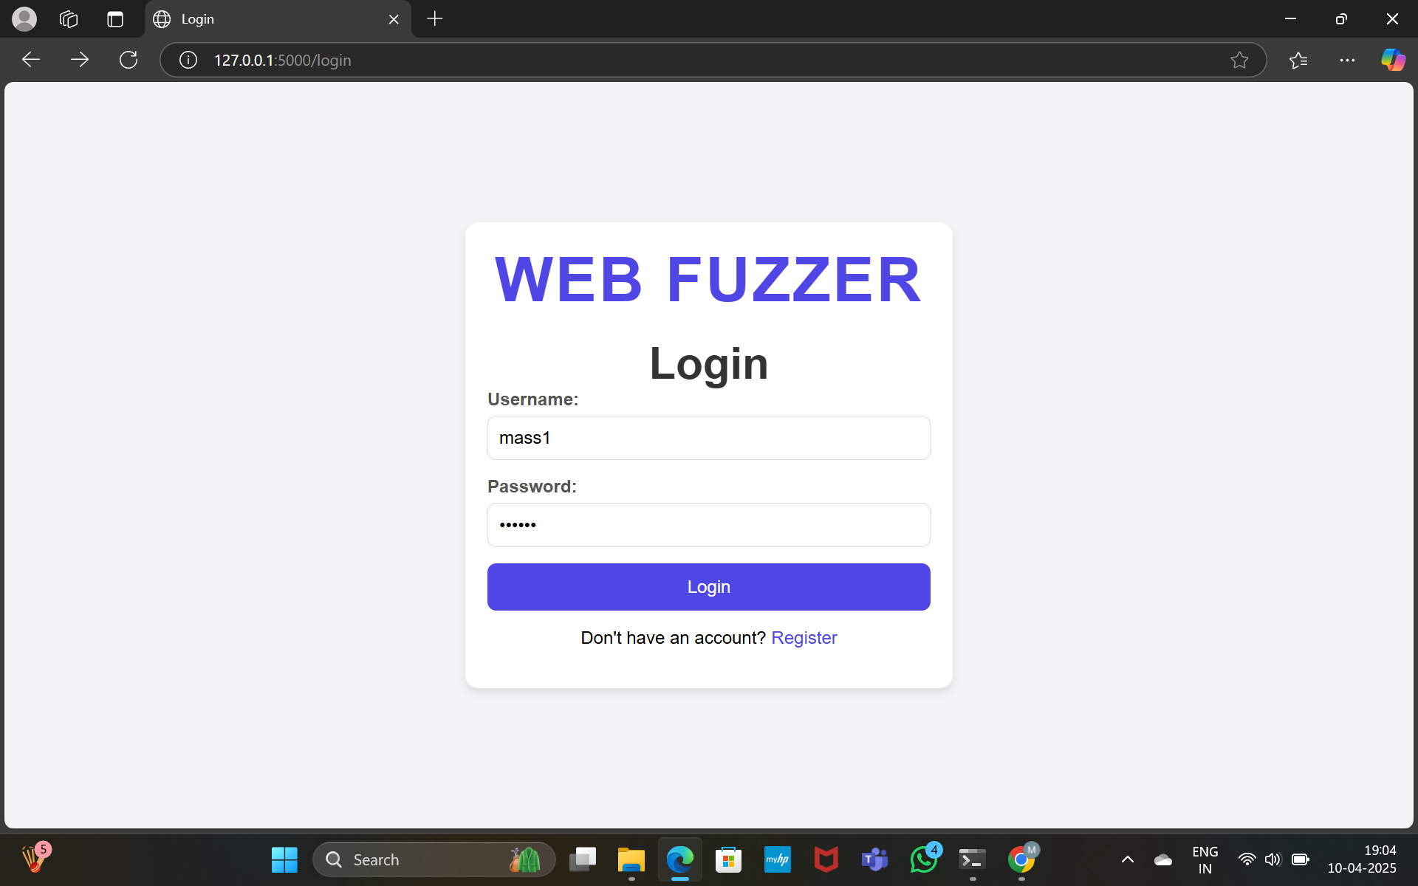
Results

Slide 17
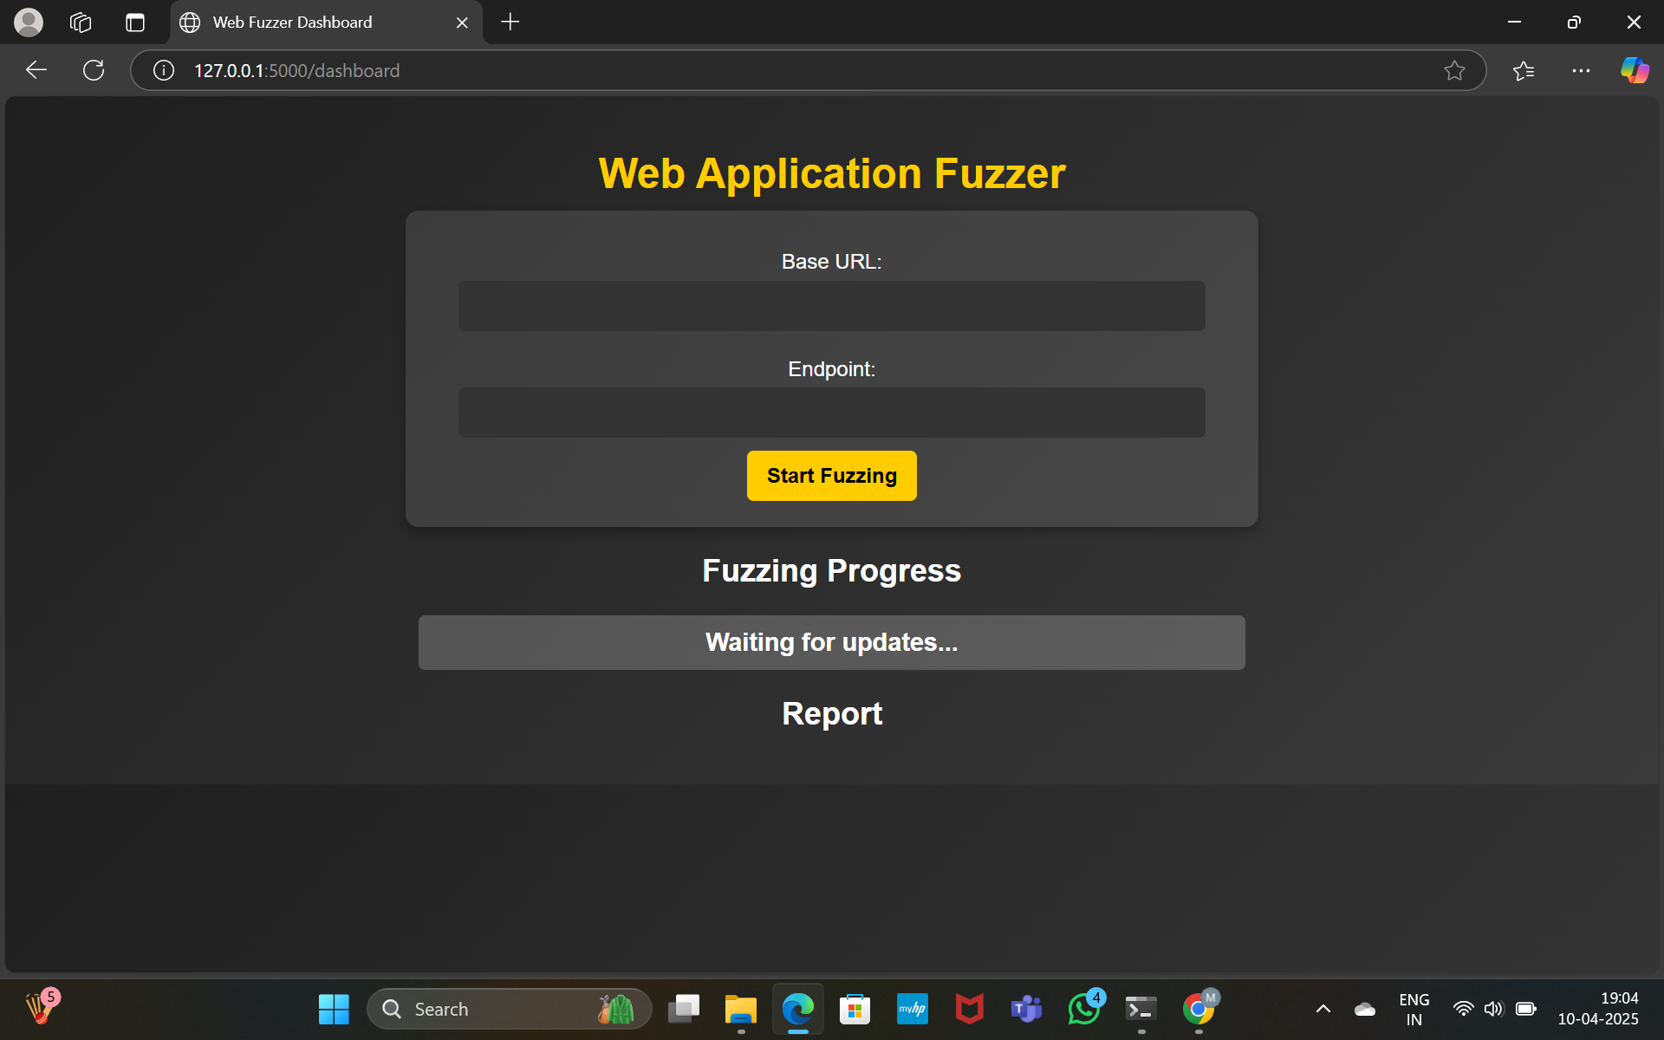
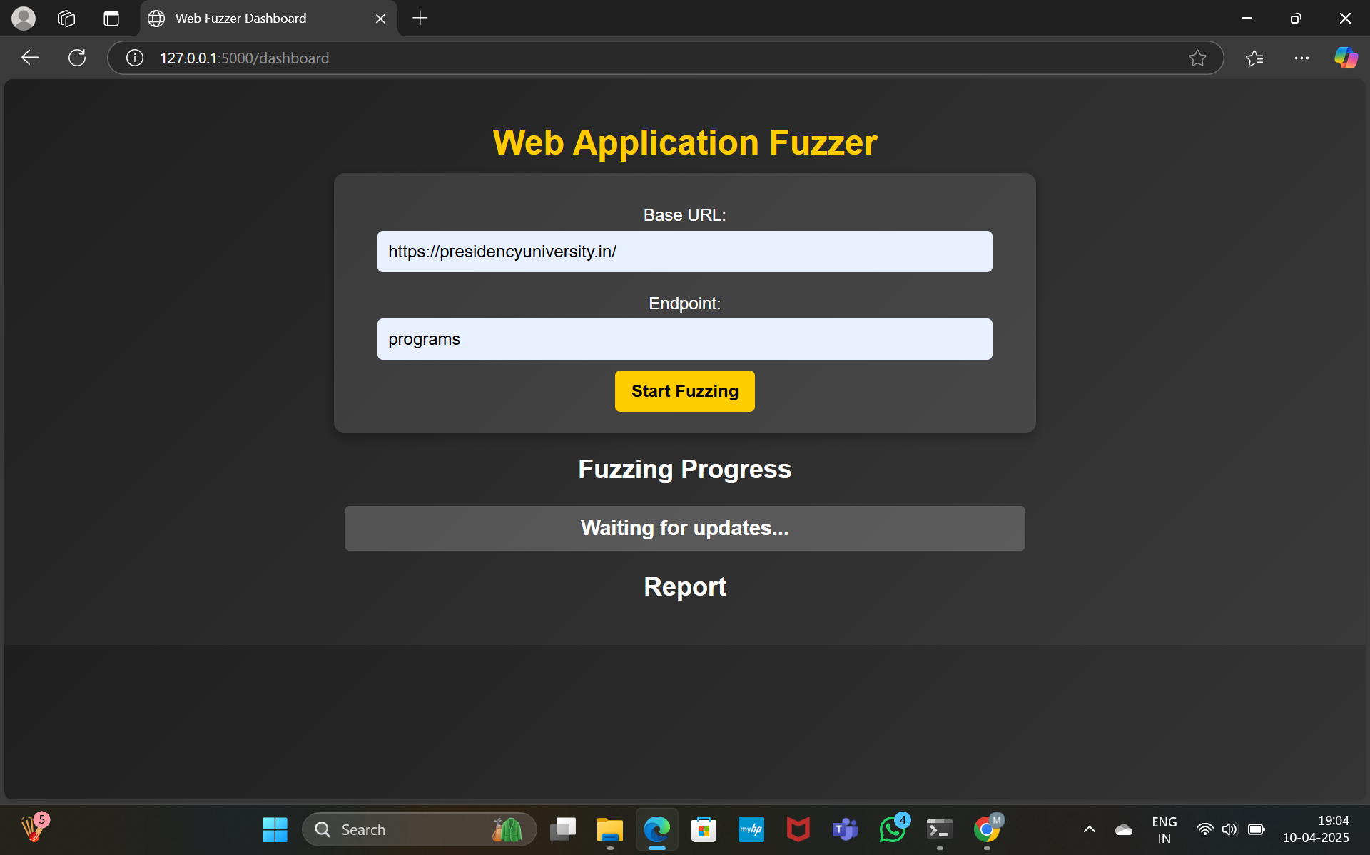

Slide 18
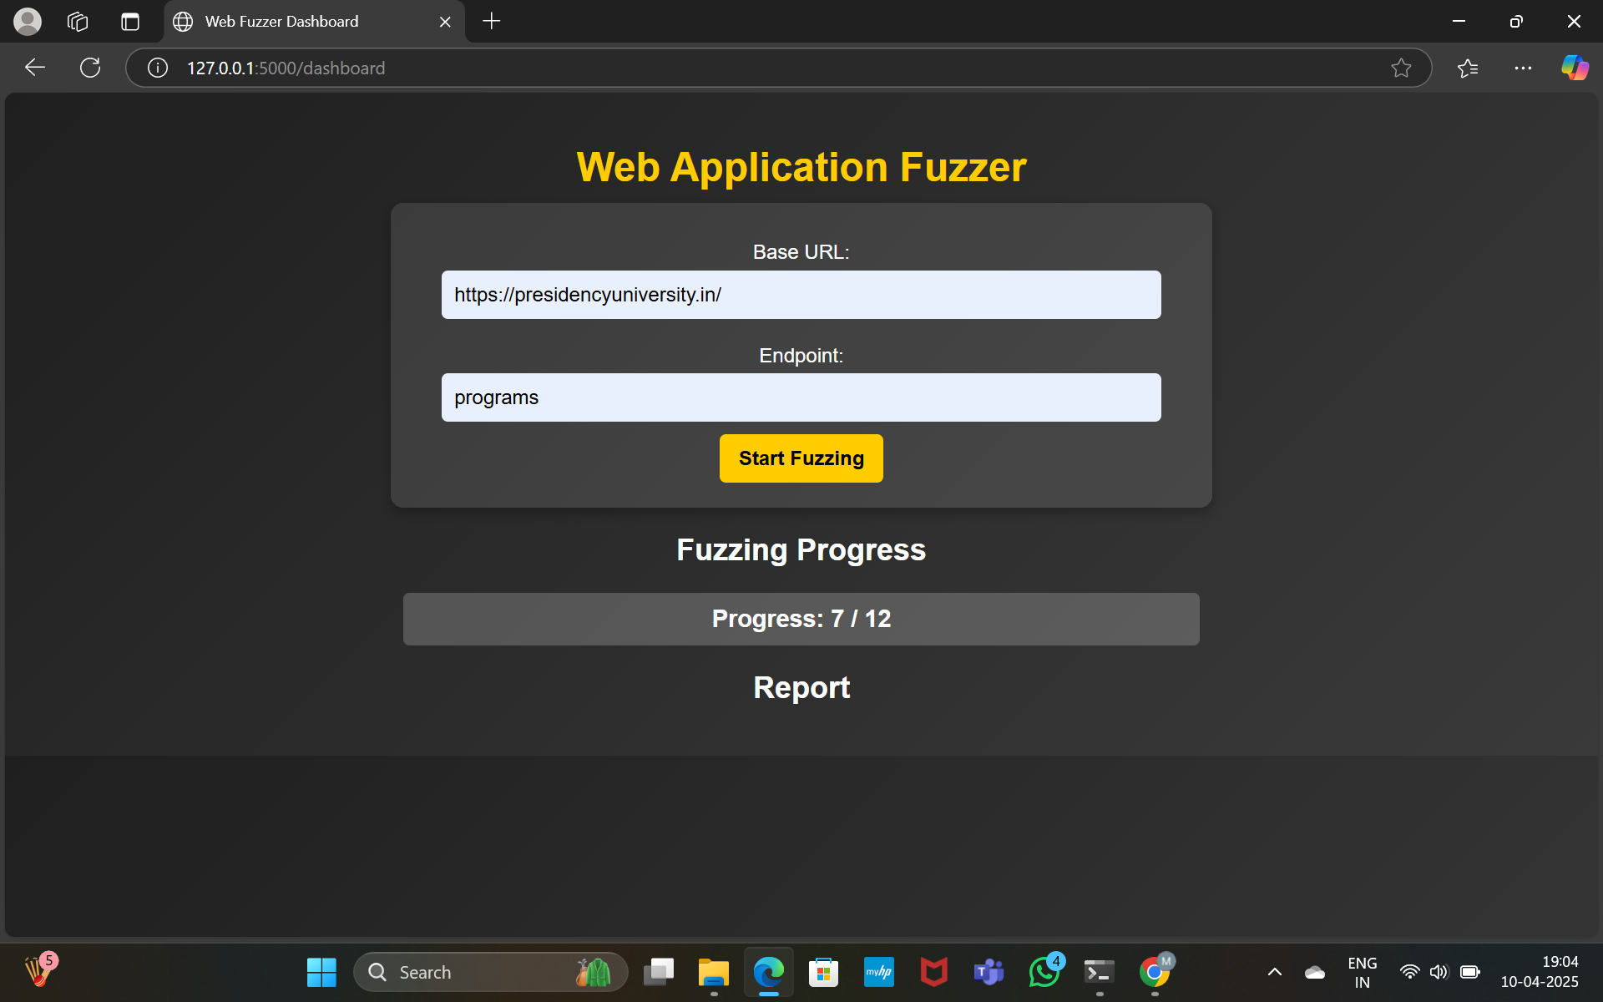
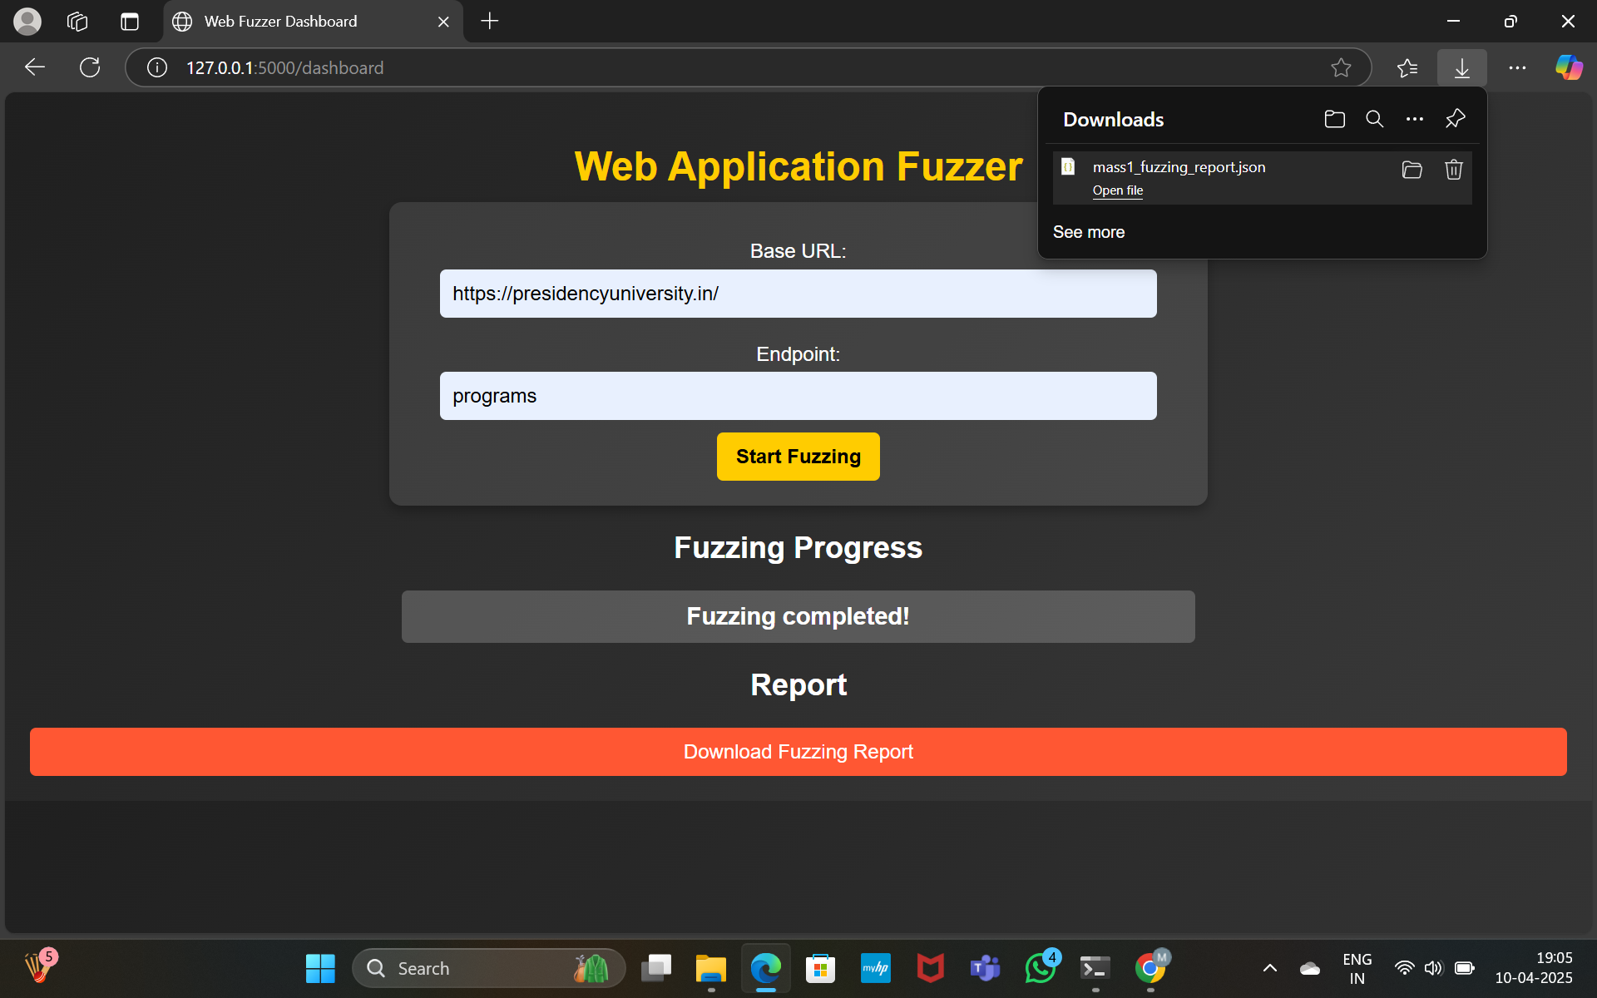

Slide 19
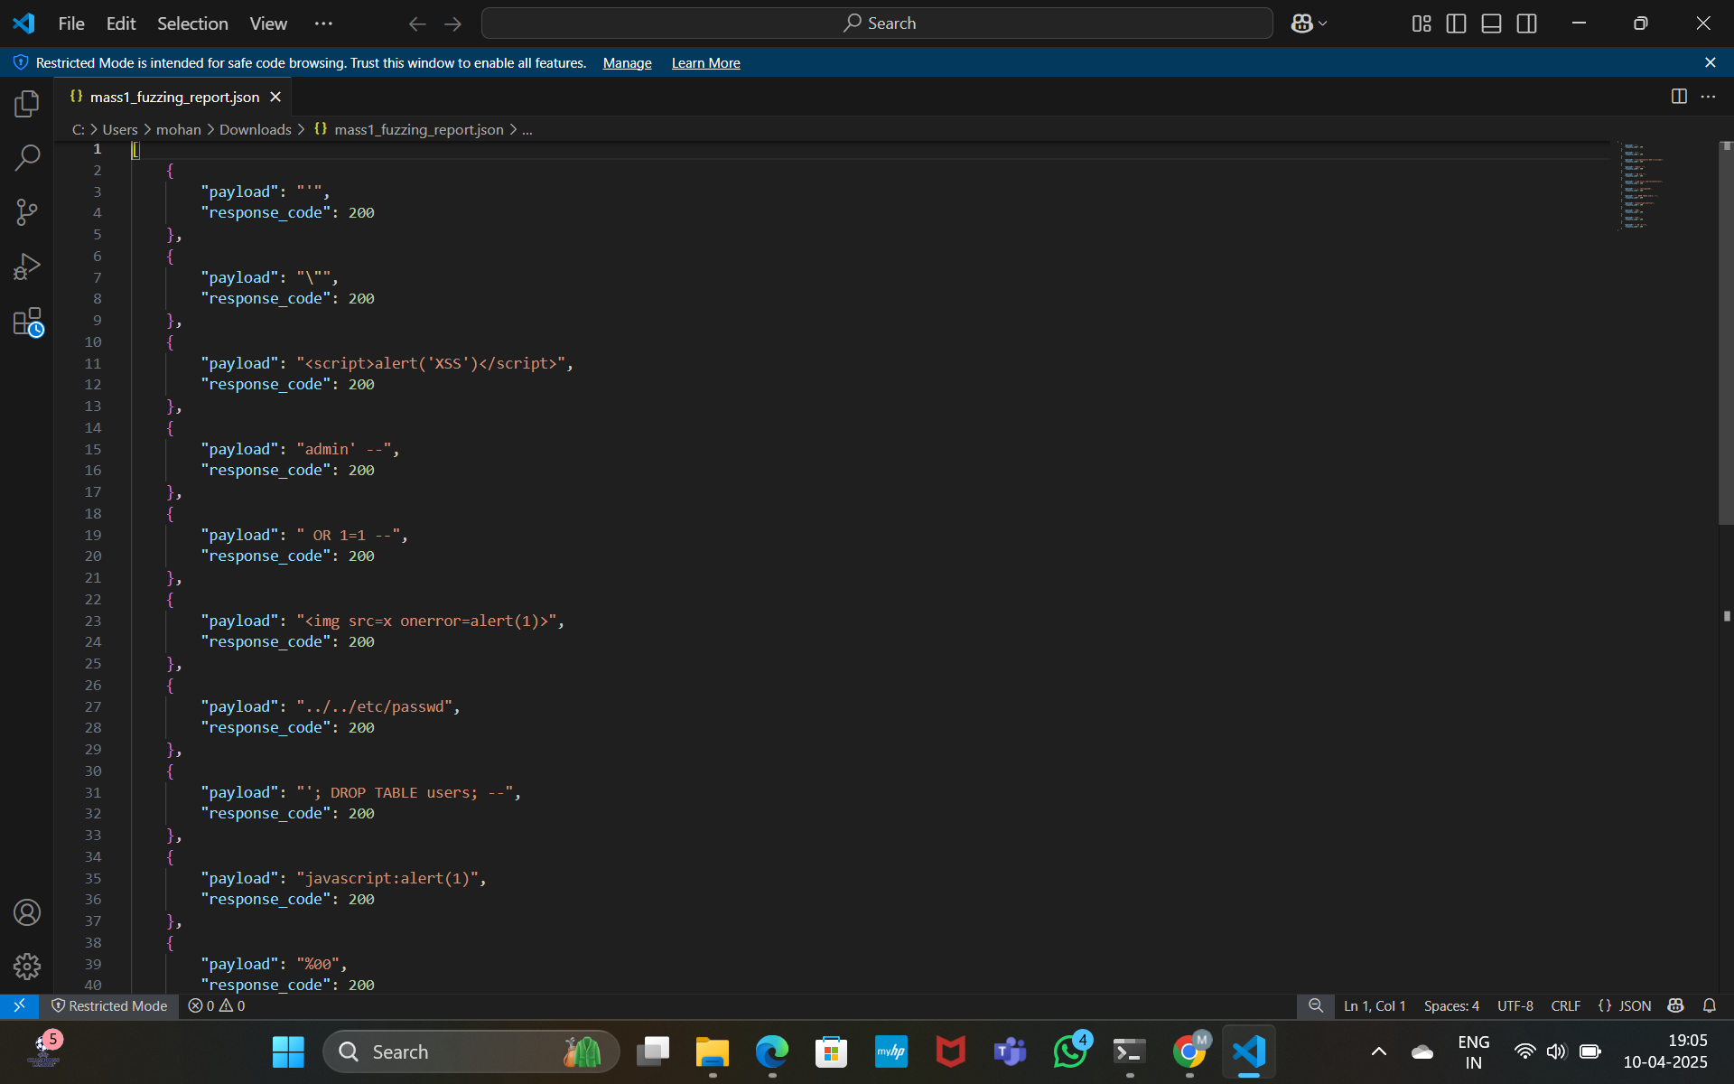
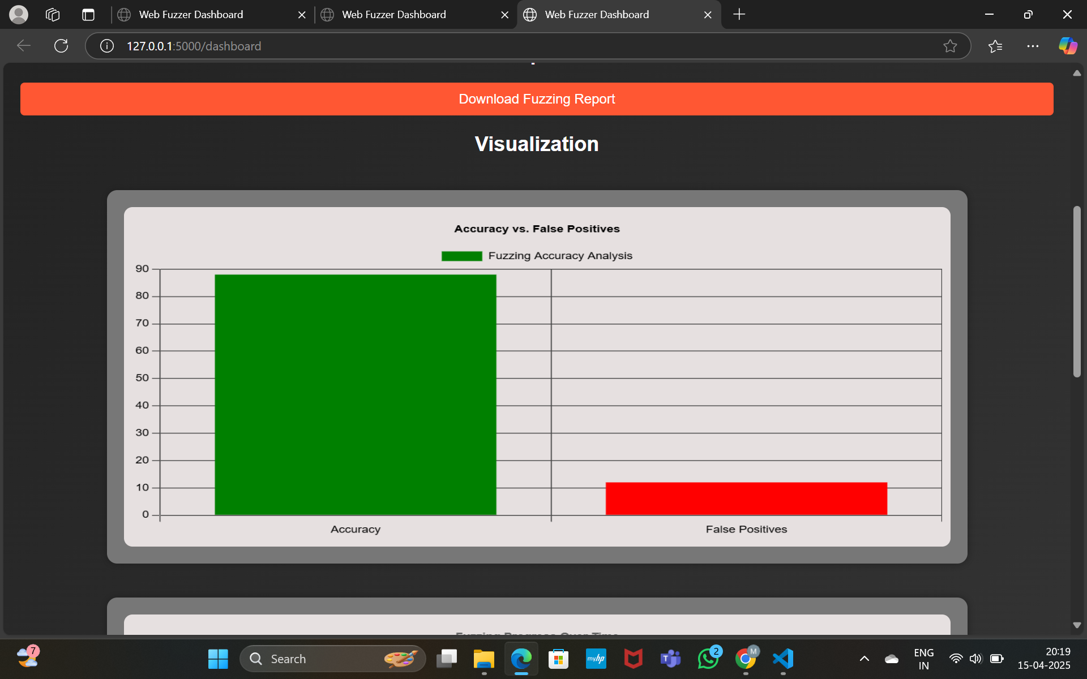

Slide 20
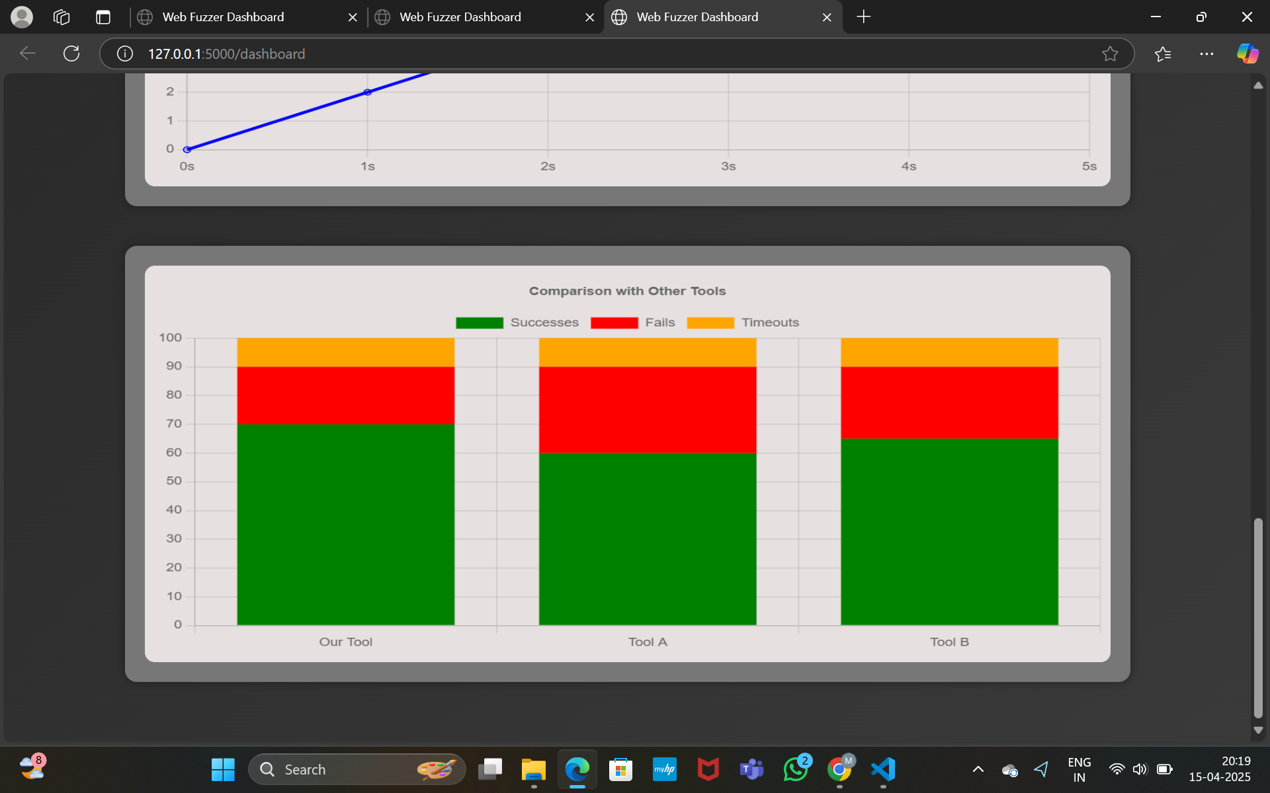
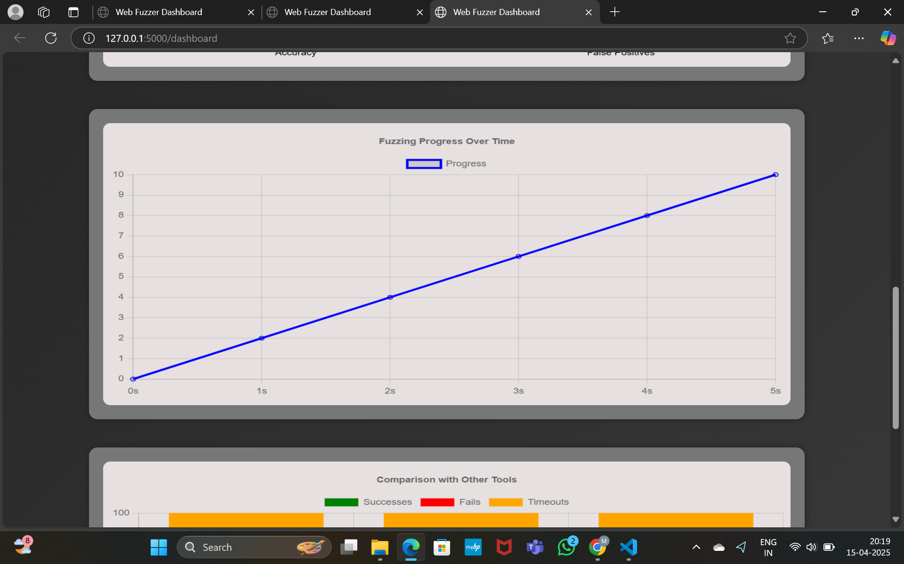

Slide 21


